Slide 1



EFFECTS OF MUSIC ON
MENTAL HEALTH
Githendra Balaji
Ryan Fiannaca
Shanmukh Sai Yadav Godha
Zizhuo Chen
1:23
2:36

Slide 2

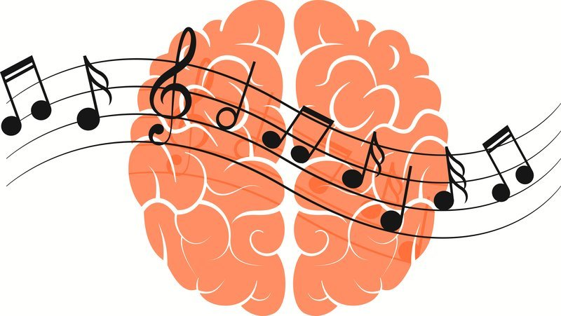

PURPOSE AND DATA
Surveys conducted on users of streaming services to improve music standards and help people with mental issues
Gathered information on listen frequency, mental illnesses, and effect of music on mental health

Slide 3
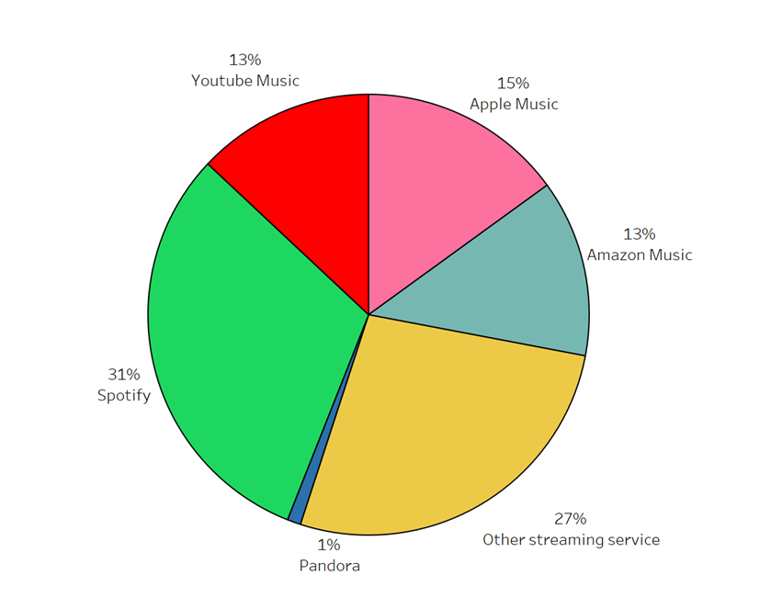
YOUTUBE MUSIC IS FALLING BEHIND IN MARKET SHARE
Spotify is currently leading the music streaming market
Youtube Music is tied for the third position in market share

Slide 4
EFFECTS OF MUSIC ON MENTAL HEALTH BASED ON
AGE
FREQUENCY
PSYCHOLOGY
- Ryan Fiannaca
- Githendra Balaji
- Shanmukh Sai Yadav Godha

Slide 5

PROBLEMS RELATED TO MENTAL HEALTH
Emotional, psychological and social well-being
Negative effects on millions of people’s mental health each year
Mental illness, physical effects and traumatic life experiences

Slide 6
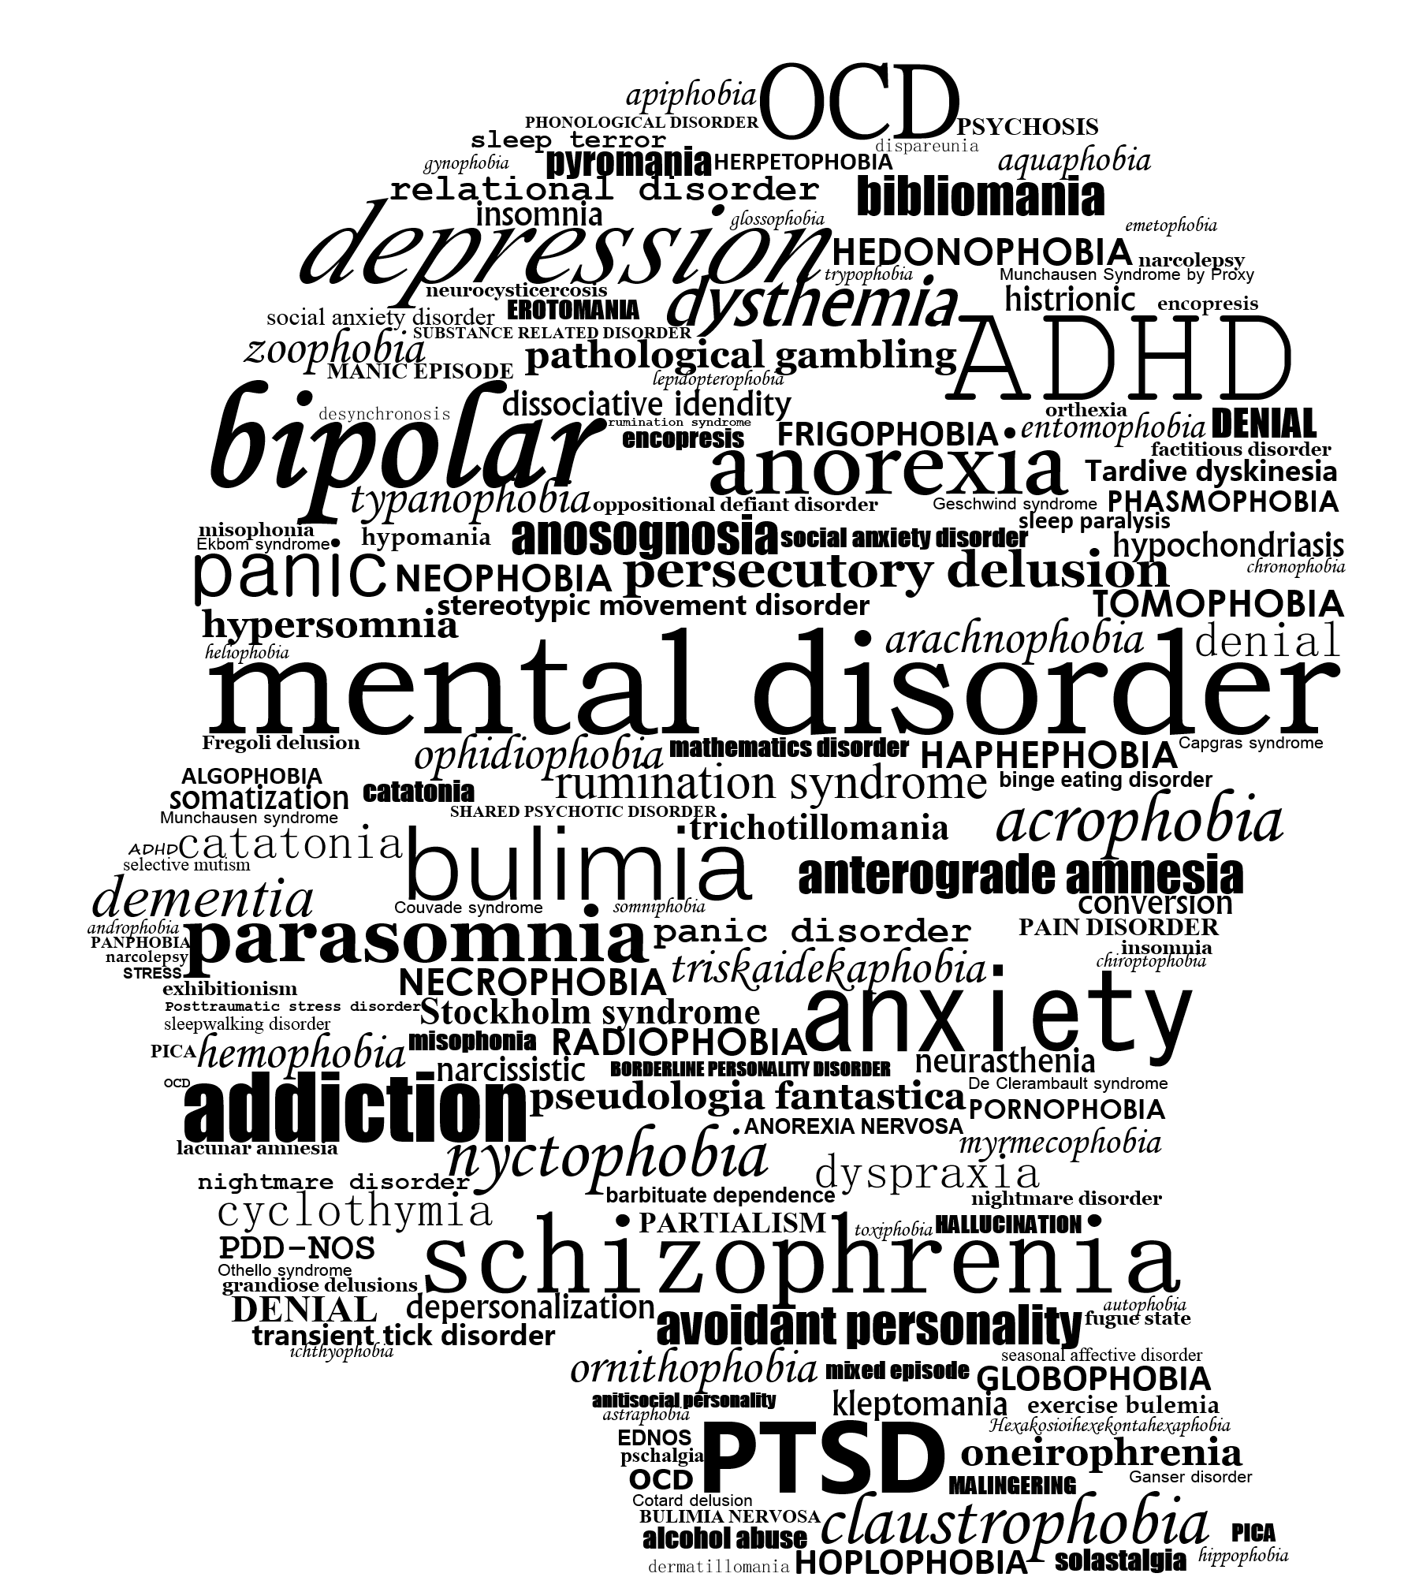
DATA OF MENTAL HEALTH IN UNITED STATES
1 in 5
adults in America experience a mental illness at some point in their lives
75%
of all chronic mental illness begin by the age of 24

Slide 7
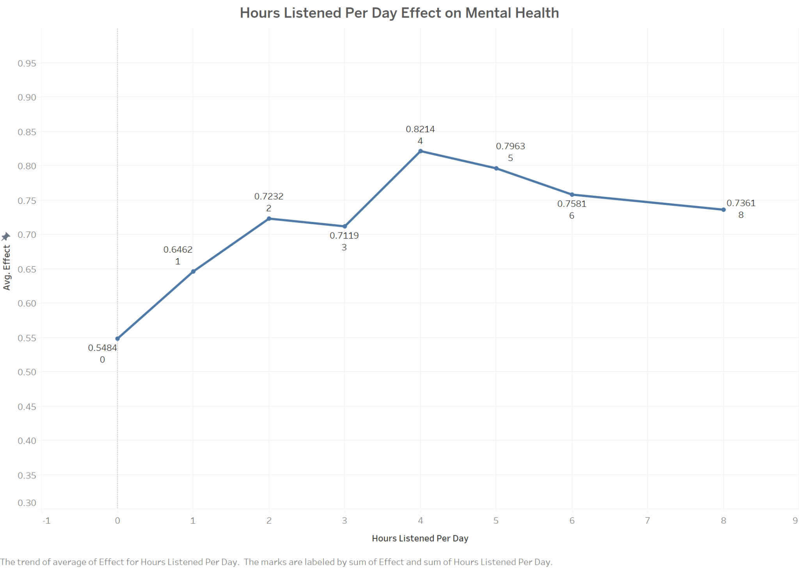
LISTENING TO MUSIC IMPROVES MENTAL HEALTH
-1 is a negative effect
0 is no effect
1 is positive effect
Each hour has an average effect > 0
4 hours a day has greatest positive effect

Slide 8
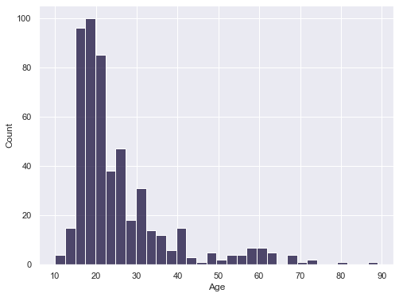
FREQUENCY OF LISTENING TO MUSIC IS INCREASED AMONG GEN-Z
40% of the data collected are listeners aged 20-30
Users of music streaming services tend to be younger than 40
75% under 40 years old

Slide 9
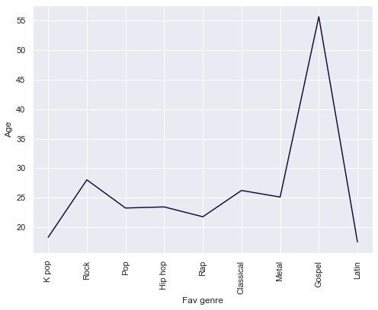
FAVORITE GENRE BASED ON AGE GROUP
K-Pop and Latin genres are popular among the younger generation of people typically less than the age of 20
Gospel is very popular among older generation people who are more than 50 years of age
People between the age group of 20-30 are listening to all genres of music

Slide 10
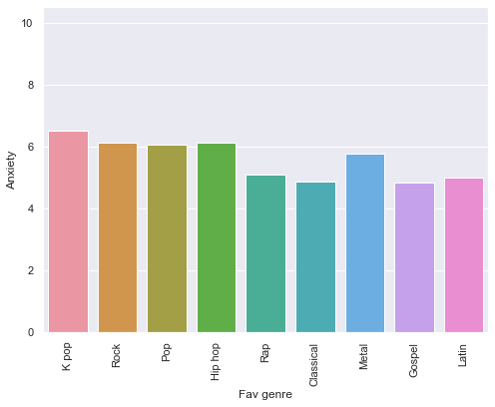
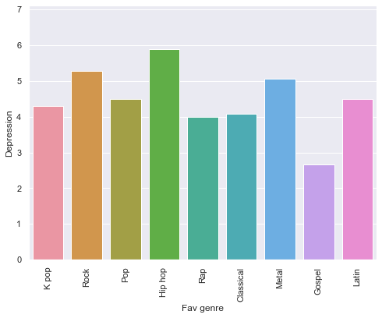
HIP HOP WORSENS IN ANXIETY & DEPRESSION LEVELS

Slide 11
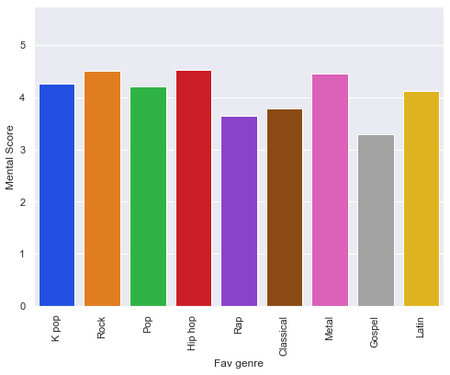
MENTAL SCORE BASED ON GENRE - GOSPEL RANKS BEST
The Gospel genre is the best of all the genres considering the mental score
Hip-Hop is the worst when it comes to mental relief

Slide 12
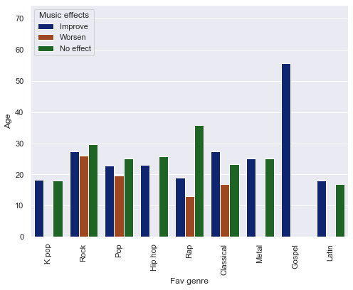
EFFECTS OF MUSIC ON MENTAL HEALTH BASED ON AGE & GENRE
Gospel genre is the most improved genre for older age people which is 50+ age
Rap genre has the least improved effect on age group who are below 40 years
Rock genre has shown the maximum worsen effect on younger

Slide 13
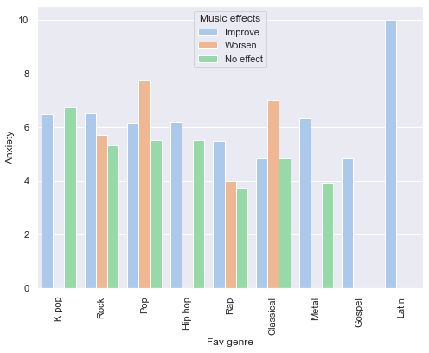
EFFECTS OF MUSIC ON ANXIETY BASED ON GENRE
Latin genre music has improved the most in related to anxiety issues
Pop Genre music has the most worsen effect
K Pop has highest no effect on people who has anxiety related isssues

Slide 14
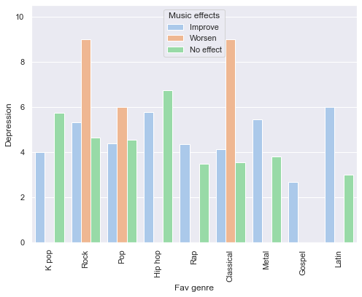
EFFECTS OF MUSIC ON DEPRESSION BASED ON GENRE
Latin genre music has improved the most in related to depression issues
Rock and Classical Genre music has the most worsen effect towords depression
Hip Hop has highest no effect on people who has depression related isssues

Slide 15
RECOMMENDATIONS
Social well-being
Acheivement
psychological
Competitors

Slide 16

A picture is worth a thousand words!
THANK YOU

